Slide 1
Synchronous Motor

Slide 2
Content:
Types of Synchronous Motor
Construction of Synchronous motor
Working of Synchronous motor
Advantages, Disadvantages and Applications of Synchronous motor

Slide 3
Introduction to Synchronous Motor
If a three phase supply is given to the stator of a three phase alternator, it can work as a motor.
As is driven at synchronous speed, it is called synchronous generator.
So if alternator is run as a motor. It will rotate at a synchronous speed.
Such a device which converts an electrical energy into a mechanical energy running at synchronous speed is called synchronous motor.
Synchronous motor works only at synchronous speed and cannot work at a speed other
than the synchronous speed.

Slide 4
Types of Synchronous Motor
Three phase synchronous motors.
Single phase synchronous motor.
The single phase synchronous motor are further classified as
reluctance motor
hysteresis motor

Slide 5
Types of Synchronous Motor
The three phase synchronous motor works on the concept of rotating magnetic field. The field produced
by stationary three phase winding, which rotates in space is called rotating magnetic field. Its speed is
always synchronous and given by,
Ns = 120f/P
Where P = Number of poles for which winding is wound
f = Frequency of the supply.

Slide 6
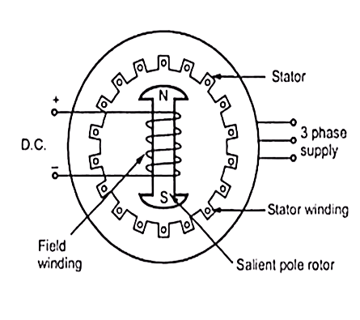
Construction of Three Phase Synchronous Motor
• There is no difference between the construction of synchronous motor and the alternator, both being the synchronous machines.
• The synchronous motor construction is basically similar to rotating field type alternator. It consists of two parts:
Stator:
Consisting of a three phase star or delta connected winding. This is excited by a three phase a.c. supply.
Rotor:
Rotor is a field winding, the construction of which can be salient (projected pole) or non-salient (cylindrical) type.
Practically most of the synchronous motors use salient i.e. projected pole type construction.
The field winding is excited by a separate d.c. supply through slip rings.

Slide 7
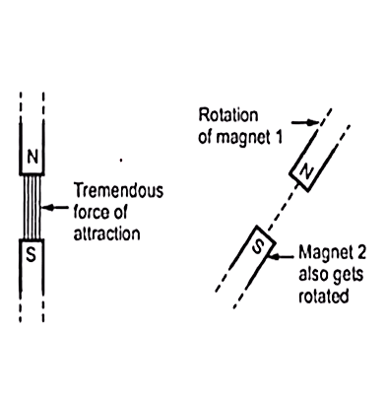
Working of Three Phase Synchronous Motor
Principle of the magnetic locking.
When two unlike poles - tremendous force of — strong attraction -magnetically locked.
If one magnet rotate - the other also rotates - in the same direction - with the same speed - due to magnetic locking condition.
Stator is wound for 2 poles - two magnetic fields are produced
- When three phase winding is excited - the flux produced - is always of rotating type - rotates at a speed called synchronous speed
This magnetic field is called rotating magnetic field.

Slide 8
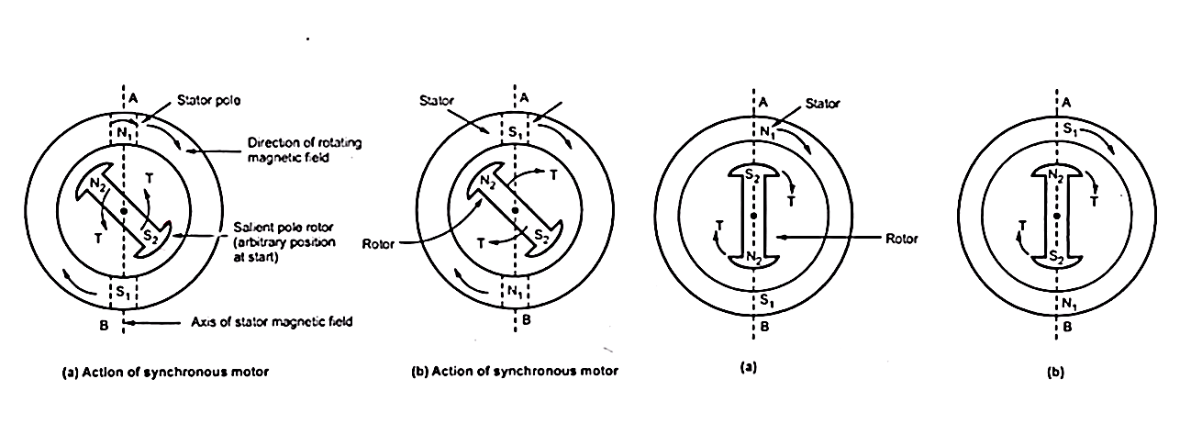
Working of Three Phase Synchronous Motor

Slide 9
Procedure to start a Three Phase Synchronous Motor
Various methods to start the synchronous motor are,
Using pony motors
Using damper winding
As a slip ring induction motor
Using small d.c. machine coupled to it.

Slide 10
Comparison of Three Phase Synchronous Motor and Induction Motor
No | Synchronous motor | Induction motor
1 | Construction is complicated | Construction is simpler, particularly in case of cage rotor.
2 | not self starting. | self starting.
3 | Motor is sensitive to sudden load changes and hunting results. | Rotor gets excited by the induced e.m.f. so separate source is not necessary.
4 | he speed is always synchronous irrespective of load. | The speed is always less than synchronous but never synchronous.
5 | Speed control is not possible. | Speed control possible though difficult.
6 | As load increases, load angle increase keeping speed constant as synchronous. | as load increases, the speed keeps on decreasing.
7 | By changing excitation, the motor p.f can be changed from lagging and leading. | It always operates at lagging p.f and p.f control is not possible.
8 | It can be used as synchronous condenser for p.f. improvement. | It can not be used as a synchronous condenser.
9 | Motor is sensitive to sudden load changes and hunting results. | Phenomenon of hunting is absent.
10 | Motor is costly and requires frequent maintenance. | motor is cheap specially cage motor are maintenance free.

Slide 11
Advantages, Disadvantages and Application of Three Phase Synchronous Motors
Advantages | Disadvantages | Applications
High Efficiency at high speeds | Expensive when compared with induction motor | AC, Compressors
Maintenance and installation is easy | Difficult to start | Large power systems to improve leading and lagging power factor
Maintains full torque at low speeds |  | Data storage units
High efficiency and reliable |  | Servo drives
Smooth torque and dynamic performance |  | Robotics and Aerospace

Slide 12
Thank You

